Slide 1

PROJECT - I (BCA 581) 2024 -2025 SustainLink (Surplus finds Purpose)
Under the supervision of SMITHA VINOD
Associate Professor
Team Members:
Aaryan Singh - 2241102
Akshita Mathur - 2241109
Soravich Pinrat - 2241158
MISSION
CHRIST is a nurturing ground for an individual’s holistic development to make effective contribution to the society in a dynamic environment
VISION
Excellence and Service
CORE VALUES
Faith in God | Moral Uprightness Love of Fellow Beings
Social Responsibility | Pursuit of Excellence
1

Slide 2
Agenda
CHRIST
Deemed to be University
Introduction
Title: SustainLink
Objectives
Existing Systems
Limitations
Modules/Frontend
Backend Technologies
Database Dictionary
Data Flow Diagram
Demo
How will we Upgrade?
Thankyou

Slide 3
Introduction
CHRIST
Deemed to be University
SustainLink is a visionary project designed to combat waste and enhance community welfare by connecting individuals in need with stores holding near-expiry perishable products. This inclusive platform goes beyond food items, encompassing a wide range of perishable goods. By efficiently tracking expiration dates and fostering real-time connections, SustainLink aims to create a collaborative ecosystem where surplus essentials find purpose, benefitting both businesses and communities. Products can be either donated or bought as per needs of the supplier and buyer.
When fresh goods arrive, the app records their expiration dates. As soon as food is close to the expiry, the app alerts local charities who can then pick it up for reuse. This simple process helps stores manage inventory, prevents waste, and supports the community.

Slide 4

Title: SustainLink
CHRIST
Deemed to be University
Reshaping excess into purpose, forging connections between businesses and communities for a sustainable, impactful future.

Slide 5
Objectives
CHRIST
Deemed to be University
Combat Waste: The primary objective of SustainLink is to address and combat waste, particularly the wastage of near-expiry perishable products. By connecting individuals in need with stores holding such products, the project aims to prevent unnecessary disposal and contribute to reducing overall waste.
Efficient Expiration Date Tracking: The project aims to create an efficient system for tracking expiration dates of perishable goods. This involves the timely recording of expiration dates when fresh goods arrive and sending alerts to local charities as products approach their expiry, enabling swift action to prevent waste.
Real-time Connections: SustainLink focuses on fostering real-time connections between stores and local charities. This immediacy in communication ensures that surplus goods can be quickly identified, collected, and redistributed, minimizing the time between the availability of surplus items and their utilization.

Slide 6
Objectives
CHRIST
Deemed to be University
Inventory Management for Stores: The project benefits businesses by helping them manage their inventory effectively. By providing timely alerts and facilitating the redistribution of surplus goods, stores can optimize their stock levels, reduce waste, and contribute to sustainable business practices.
Optimize Resource Utilization: By facilitating the reuse of near-expiry perishable products, SustainLink contributes to the optimization of resource utilization. This involves ensuring that resources are utilized to their fullest potential, reducing unnecessary waste and promoting a more sustainable approach to consumption.

Slide 7
Existing Systems
CHRIST
Deemed to be University
Remedico: This platform uses AI to predict and optimize medicine stocks in healthcare facilities, reducing pharmaceutical waste and improving resource allocation.
Feeding India: This non-profit distributes surplus food from grocery stores, restaurants, and other sources to people in need. They have a network of volunteers and distribution centres across India, demonstrating community-driven food rescue.
Give and Take India: This platform connects users for sharing unwanted items, including non-food perishables, fostering a community-based approach to resource reuse.
ShareFood: This India-based app allows users to filter near-expiry food by location, price, and category. Users can also see the distance to the store, making it convenient for them to find and rescue food near them. (Similar to your focus on geographic filtering and convenience)

Slide 8
Limitations
CHRIST
Deemed to be University
Lack of Technology
Limited to one category of products - Food/Medicine/Skincare
Either Expiry Tracking or Donations

Slide 9
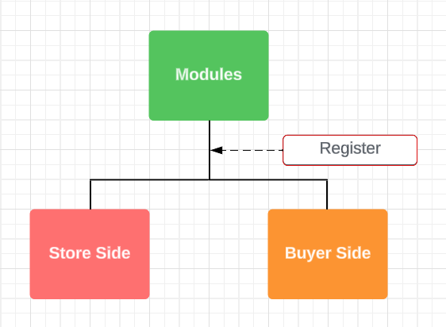
Modules
CHRIST
Deemed to be University

Slide 10
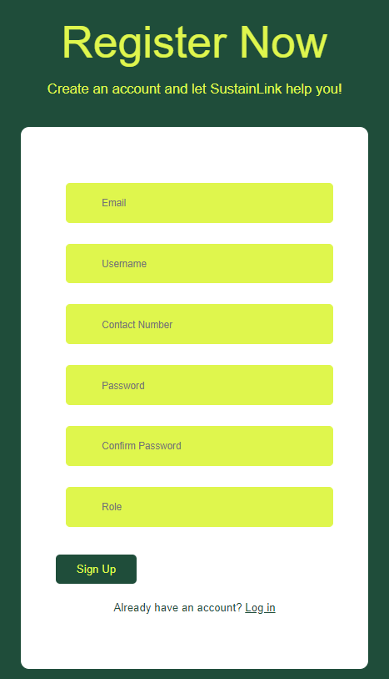
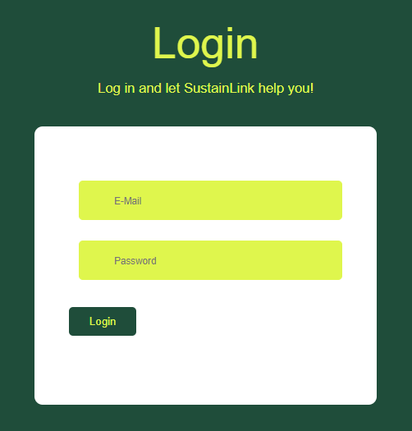
CHRIST
Deemed to be University

Slide 11
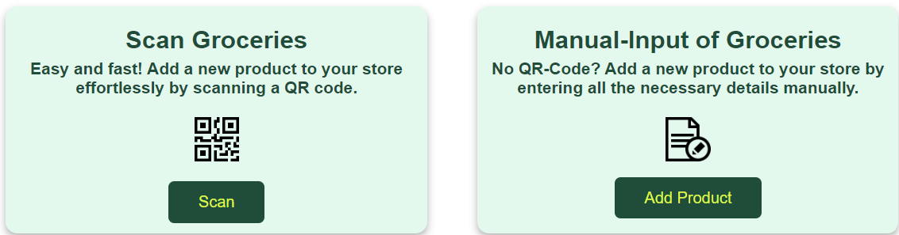
CHRIST
Deemed to be University

Slide 12
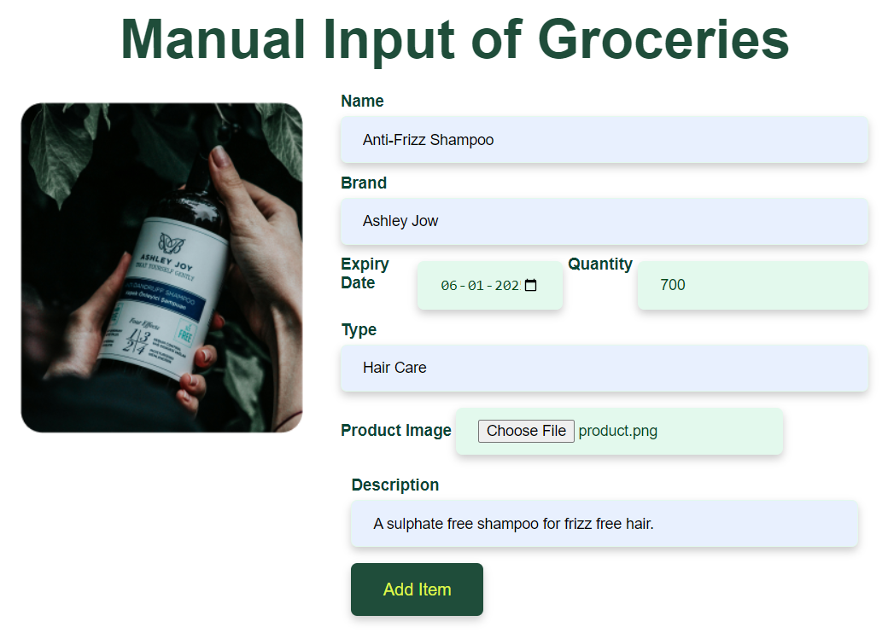
CHRIST
Deemed to be University

Slide 13
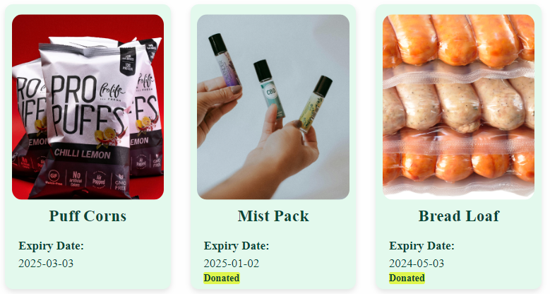
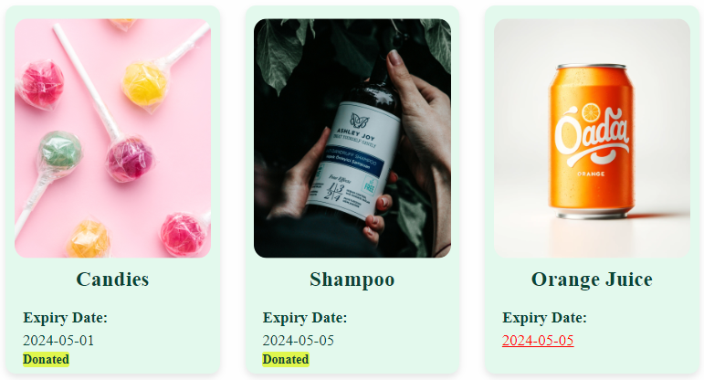
CHRIST
Deemed to be University

Slide 14
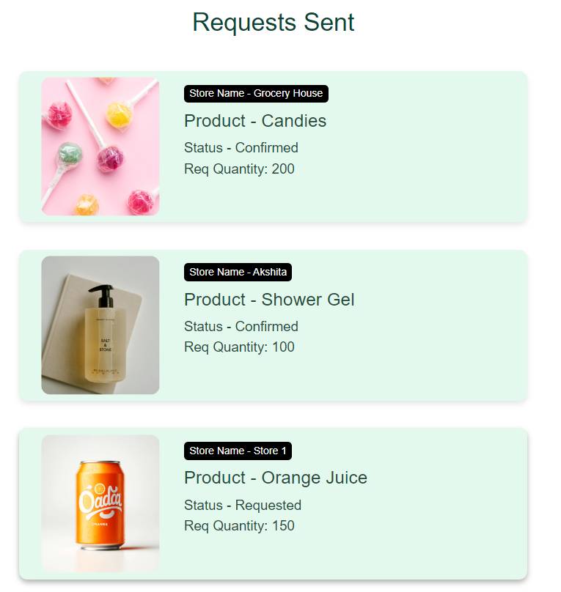
CHRIST
Deemed to be University

Slide 15



Backend Technologies
CHRIST
Deemed to be University

Slide 16
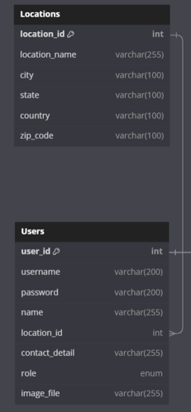
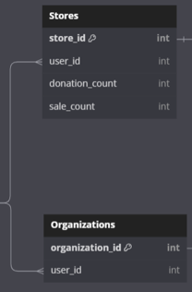
User Database
CHRIST
Deemed to be University

Slide 17
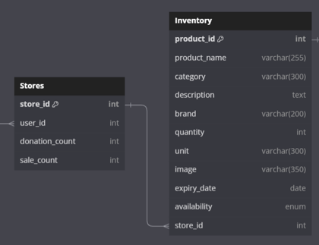
Store Database
CHRIST
Deemed to be University

Slide 18
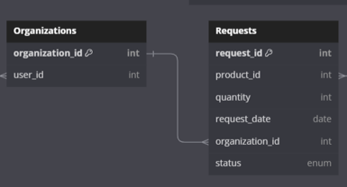
Organization Database
CHRIST
Deemed to be University

Slide 19
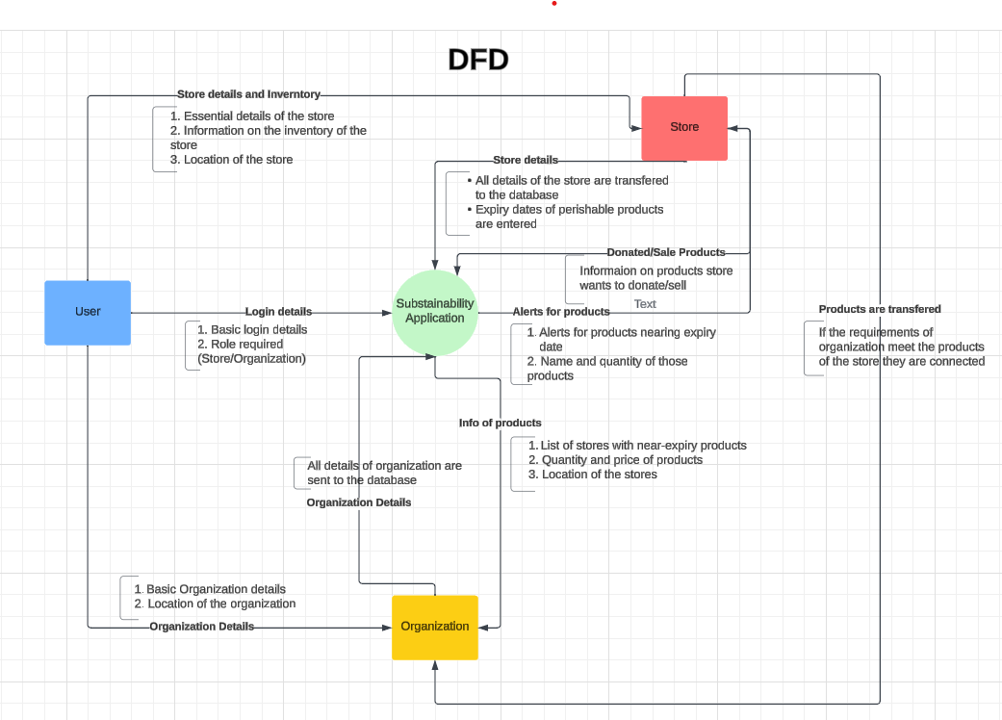
Data Flow Diagram
CHRIST
Deemed to be University

Slide 20
Data Flow Diagram
CHRIST
Deemed to be University

Slide 21
Data Flow Diagram
CHRIST
Deemed to be University

Slide 22
Data Flow Diagram
CHRIST
Deemed to be University

Slide 23
Data Flow Diagram
CHRIST
Deemed to be University

Slide 24

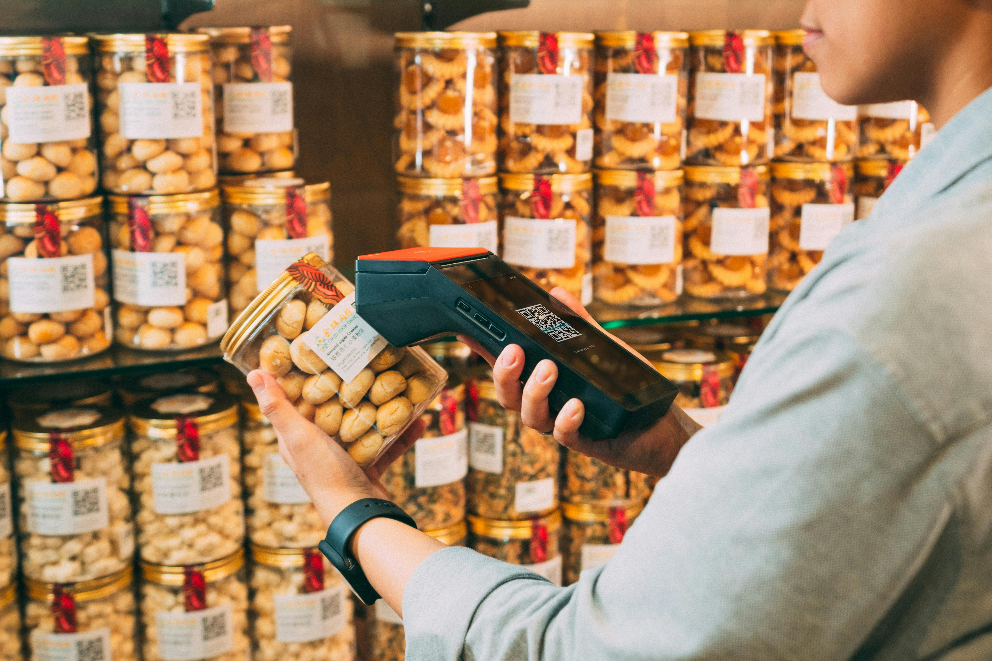

How will we upgrade?
CHRIST
Deemed to be University

Slide 25
Thank You!!
CHRIST
Deemed to be University

